Slide 1
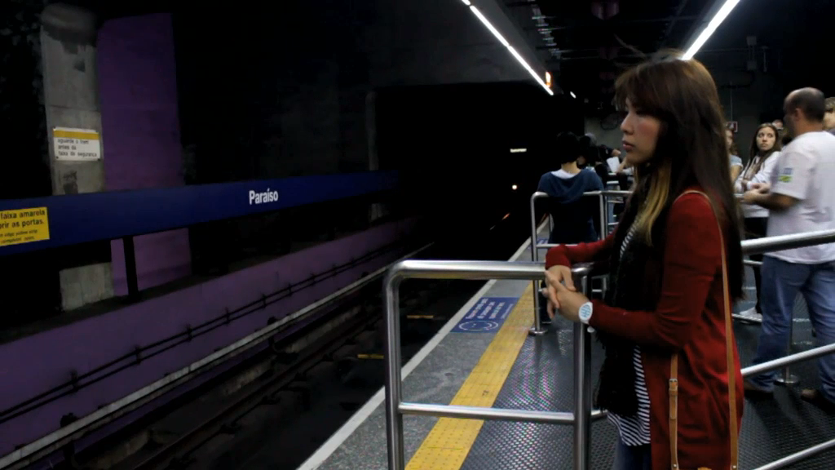


Slide 2




Slide 3
Seeing what’s happening right now, anywhere around the world.

Slide 4


Slide 5







Slide 6


182 M
Smartphone users watching videos monthly in US ALONE
300hrs/min
of uploaded videos

Slide 7



Record Video

Slide 8
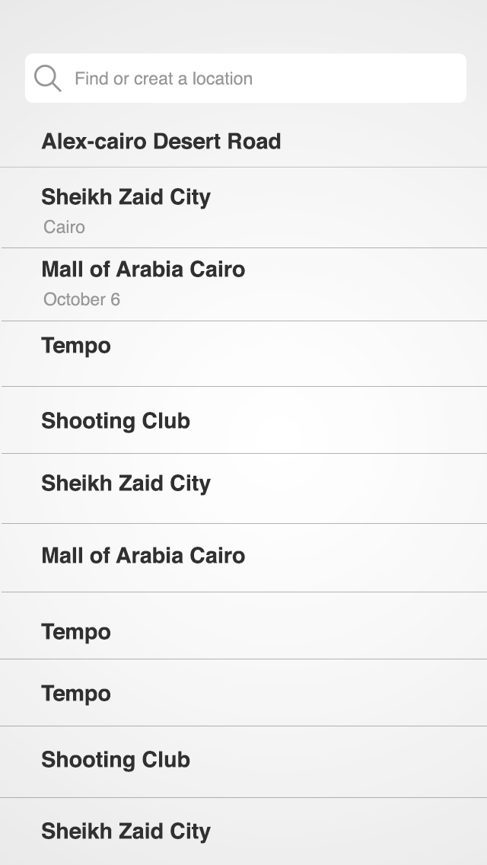
Add Location

Slide 9
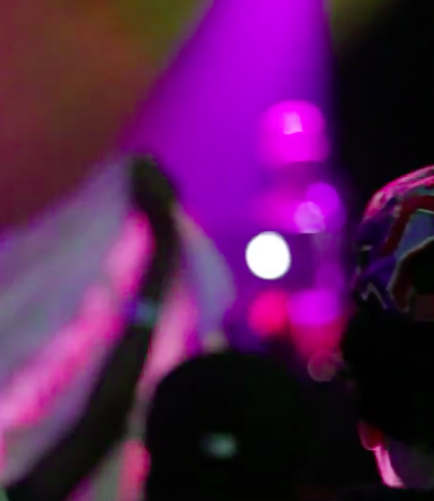
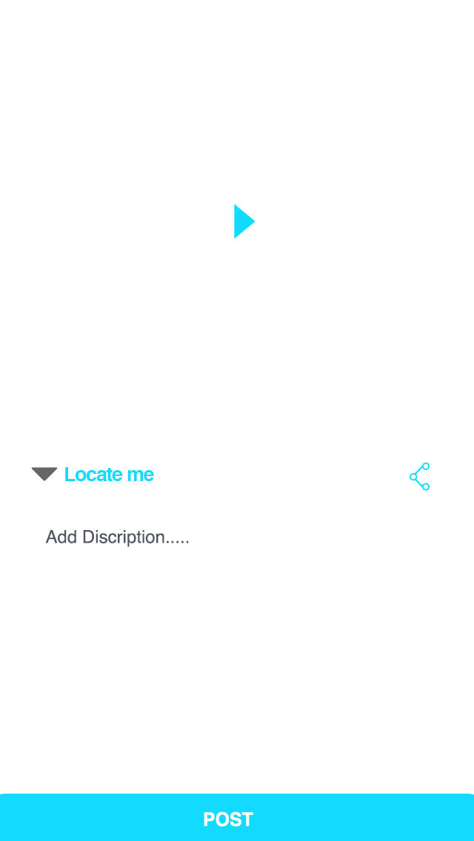
Describe &
Hashtag it!

Slide 10
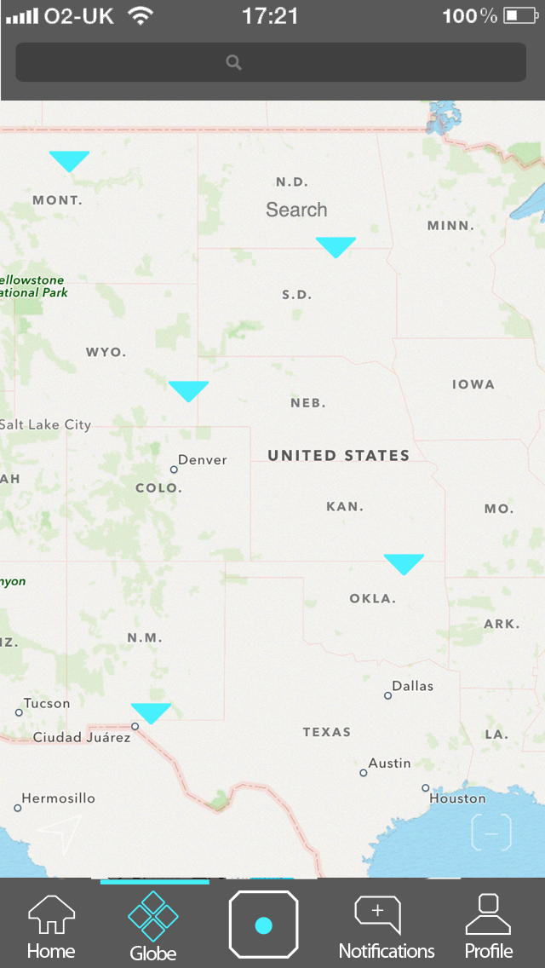
Search Everywhere
Globe View
Public Shares

Slide 11




Promote
Platform
News Channels
Video Ads

Slide 12
20+ online celebrities from 13 countries, with 1M combined followers are anxiously waiting for our launch.

Slide 13


VS.

Slide 14


Slide 15

A doesn’t lie

